Slide 1
Large Prints
IMM 120 – 9 April

Slide 2
Resolution
Every screen has a fixed number of pixels.
For example, my laptop has a resolution of 1366 x 768.
My phone has a resolution of… 1136 x 640

Slide 3
The size of my screen… obviously

Slide 4
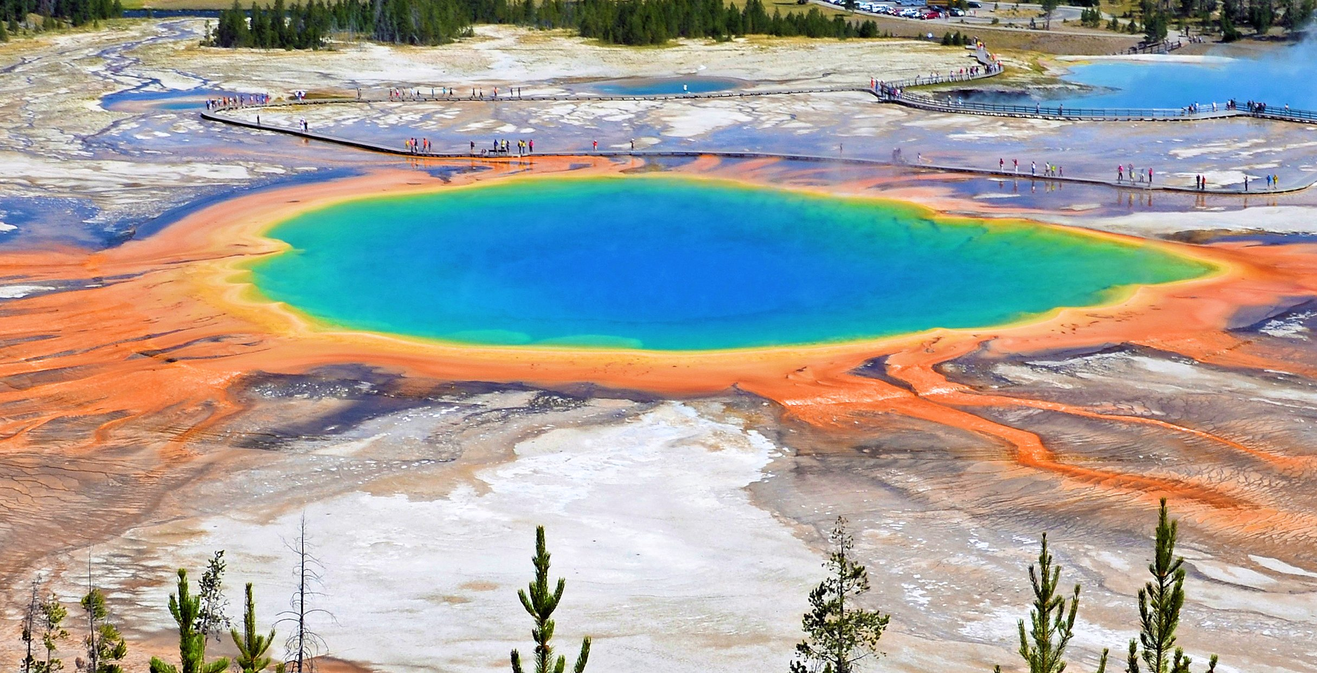

Slide 5
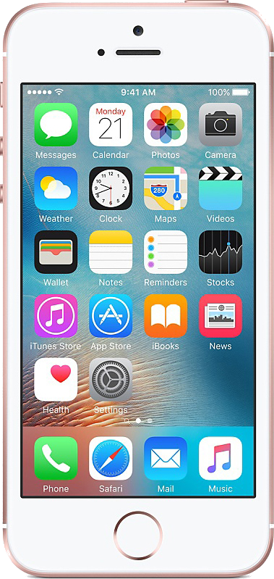

Slide 6
Pixel Density
My laptop screen has a pixel density of 72ppi.
My phone has a pixel density of 326 ppi.
ppi = points per inch
Can you guess what device has the highest pixel density?

Slide 7
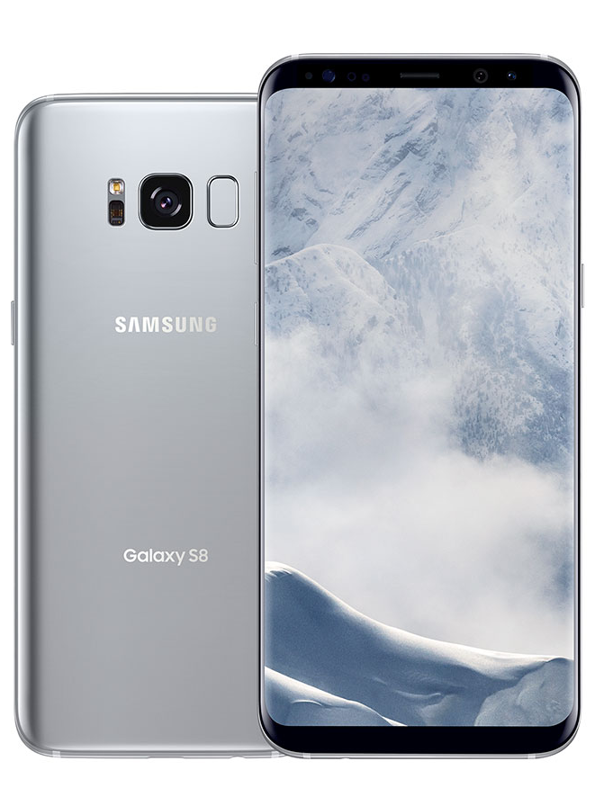
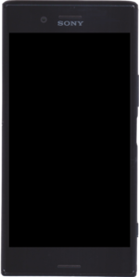
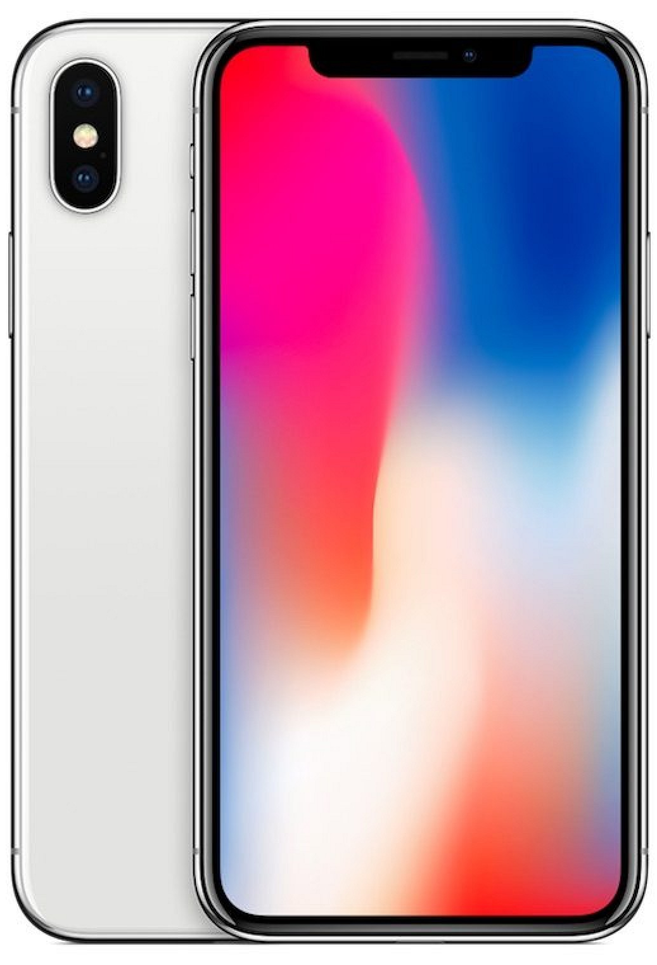

458ppi
572ppi
801ppi
Fun Fact: The human eye cannot easily distinguish differences in PPI above 300 PPi

Slide 8
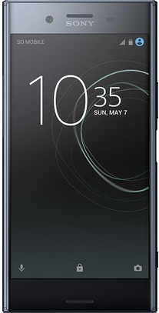
Notes:
That’s the resolution of a movie screen

Slide 9
What Does This Have to Do With Printing?
All graphics for screens are created at 72ppi.
All print graphics are 300ppi.

Slide 10

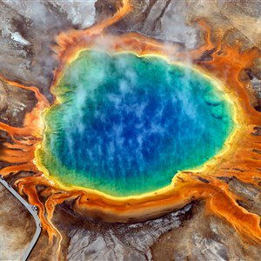
1 inch @ 72 ppi

Slide 11
1 inch @ 300 ppi

Slide 12
So We Have A Problem
The default for our p5.js editor is 400 x 400.
That’s only an inch and a third.
If we wanted to print out a sheet of paper…

Slide 13
So We Have A Problem
The default for out p5.js editor is 400 x 400.
That’s only an inch and a third at 300ppi printing density.
If we wanted to print out a sheet of paper…
We need a resolution of 3300 x 2550.
Notes:
Who has a screen big enough to handle that?

Slide 14
Offscreen Canvas
p5.js allows you to have a another canvas (or more) that isn’t immediately drawn to the screen.
https://p5js.org/examples/structure-create-graphics.html

Slide 15
Offscreen Canvas
Create canvas
var printCanvas;
function setup() {
printCanvas = createGraphics(3300, 2550);
}

Slide 16
Offscreen Canvas
Use the canvas with normal draw functions, with a prefix
function draw() {
printCanvas.background(51);
printCanvas.noStroke();
printCanvas.ellipse(
printCanvas.width/2, printCanvas.height/2, 2000
);
Notes:
Fibonacci lines (spacing = 2, += 1)

Slide 17
Offscreen Canvas
Preview the canvas by using it like an image
function draw() {
image(printCanvas, 0, 0, width, height);

Slide 18
Offscreen Canvas
Use the canvas with normal draw functions, with a prefix
function draw() {
with (printCanvas) {
background(51);
noStroke();
ellipse(width/2, height/2, 2000);
}
Notes:
Don’t have their own draw loops

Slide 19
Saving An Image
What we really want to do is make an image, so let’s do so.
function mousePressed() {
saveCanvas(printCanvas, “imageName”, “png”); // or “jpg”
Notes:
The format can be jpg or png only. GIFs are way more advanced.

